Slide 1


Automation Approach for Beazley GPAS & Billing program

Slide 2
Objectives
Scope of POC activities:
Automate & run the designated functions of GW Policy Center UI - Complete
Automate & run the Non designated functions of GW Policy Center - Complete
Automate & run the designated functions of GW Billing Centre UI - Complete
Automate & run the designated functions of GW Policy Center API - Complete
Automate & run the Customized API Testing using GT API - Complete
Automate & run the Cloud API Testing through Integration Gateway using GT API - Complete
Test Data Parameterization – From External Source (Excel) - Complete
Key Challenges & Learnings.
Key features of GT Framework.
Note: Guidewire PC and BC version : JASPER
LoB: D&O

Slide 3
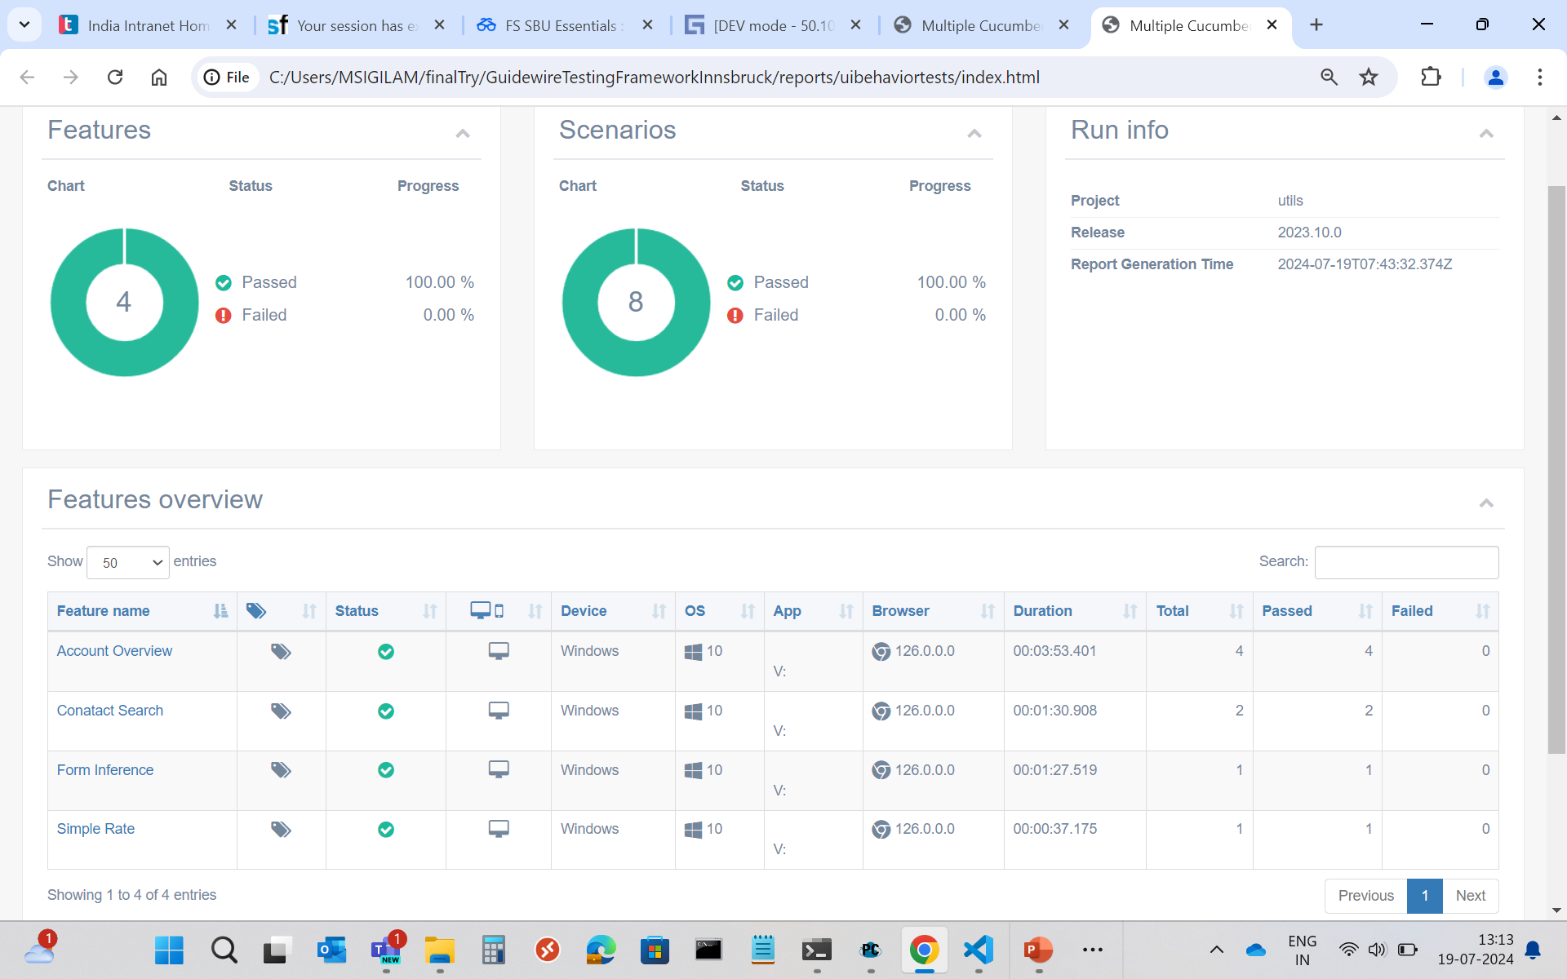
GW PC – Designated Functions – GT UI
Designated functions executed – GT UI:
Account Overview
(Shows customer account details like name, address, status etc)
Contact search
(Search the contact with First name and Last name)
Forms Inference
(View the inferred form. However, since the forms are not configured for D&O, so viewed the Forms page only)
Simple Rate
(View the premium once the submission is in quoted status. However, Rating engine is not configured , so premium is showing as blank)
Test-Data:
Execution Report:
TestType | CompanyName | Primary-Email | Address1 | City | AddressType | organization
Positive | SMK | smk@gmail.com | HB | Haines City | home | acv
Negative | MFC | 1111 | MLG | Lake City | home | acv

Slide 4
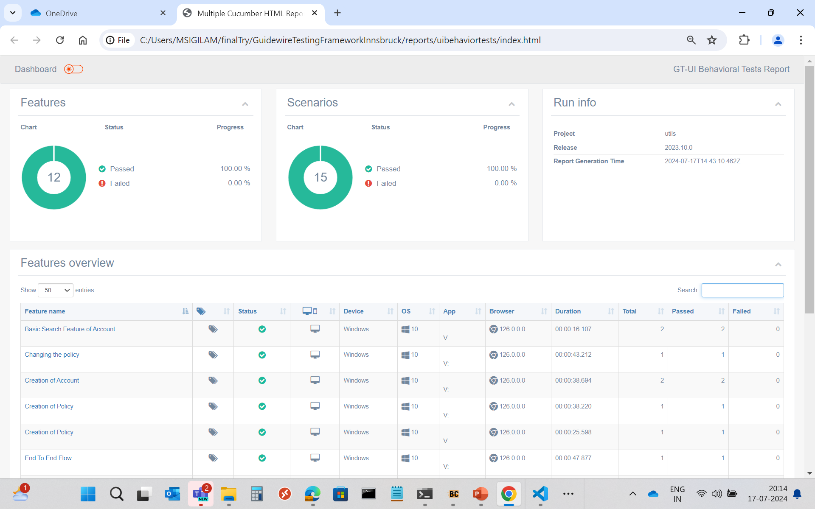
GW PC – Non-Designated Functions – GT UI
Non-Designated functions executed – GT UI:
Account creation
(New account creation by providing Name, Address, mail id, City, State and Zip code)
Quote creation
(To generate premium based on the coverages added)
Issue policy
Policy change
Cancellation
Rewrite
(End to End lifecycle of policy like issue, Change, Cancel and Rewrite)
Execution Report:
Test-Data:
TestType | CompanyName | Primary-Email | Address1 | City | AddressType | organization
Positive | SMK | smk@gmail.com | HB | Haines City | home | acv
Negative | MFC | 1111 | MLG | Lake City | home | acv

Slide 5
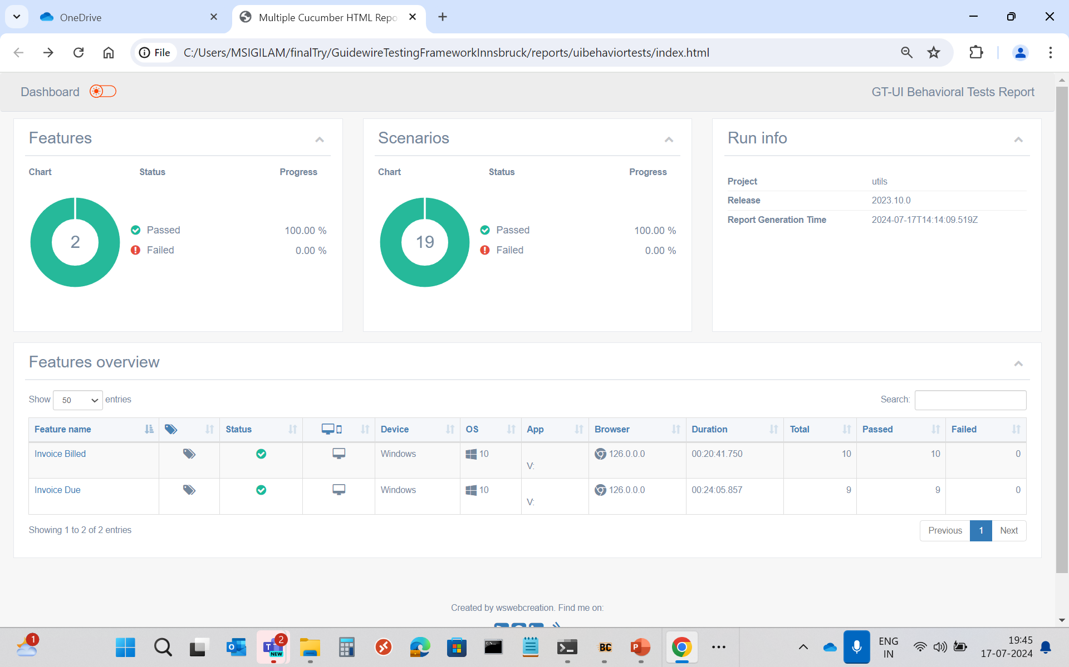
GW BC – Designated Functions – GT UI
Designated functions executed – GT UI:
Invoice Billed
(Invoice Bill summary page view)
Invoice Due
(Invoice Due amount view in summary page)
Execution Report:
Test-Data:
BillingPlan | DelinquencyPlan | Contact-State | Contact-AddressLine1 | Contact-City
QA1BILLINGPLAN01 | QA1DELINQUENCYPLAN01 | CA | 1332 Everett Street | El Cerrito

Slide 6
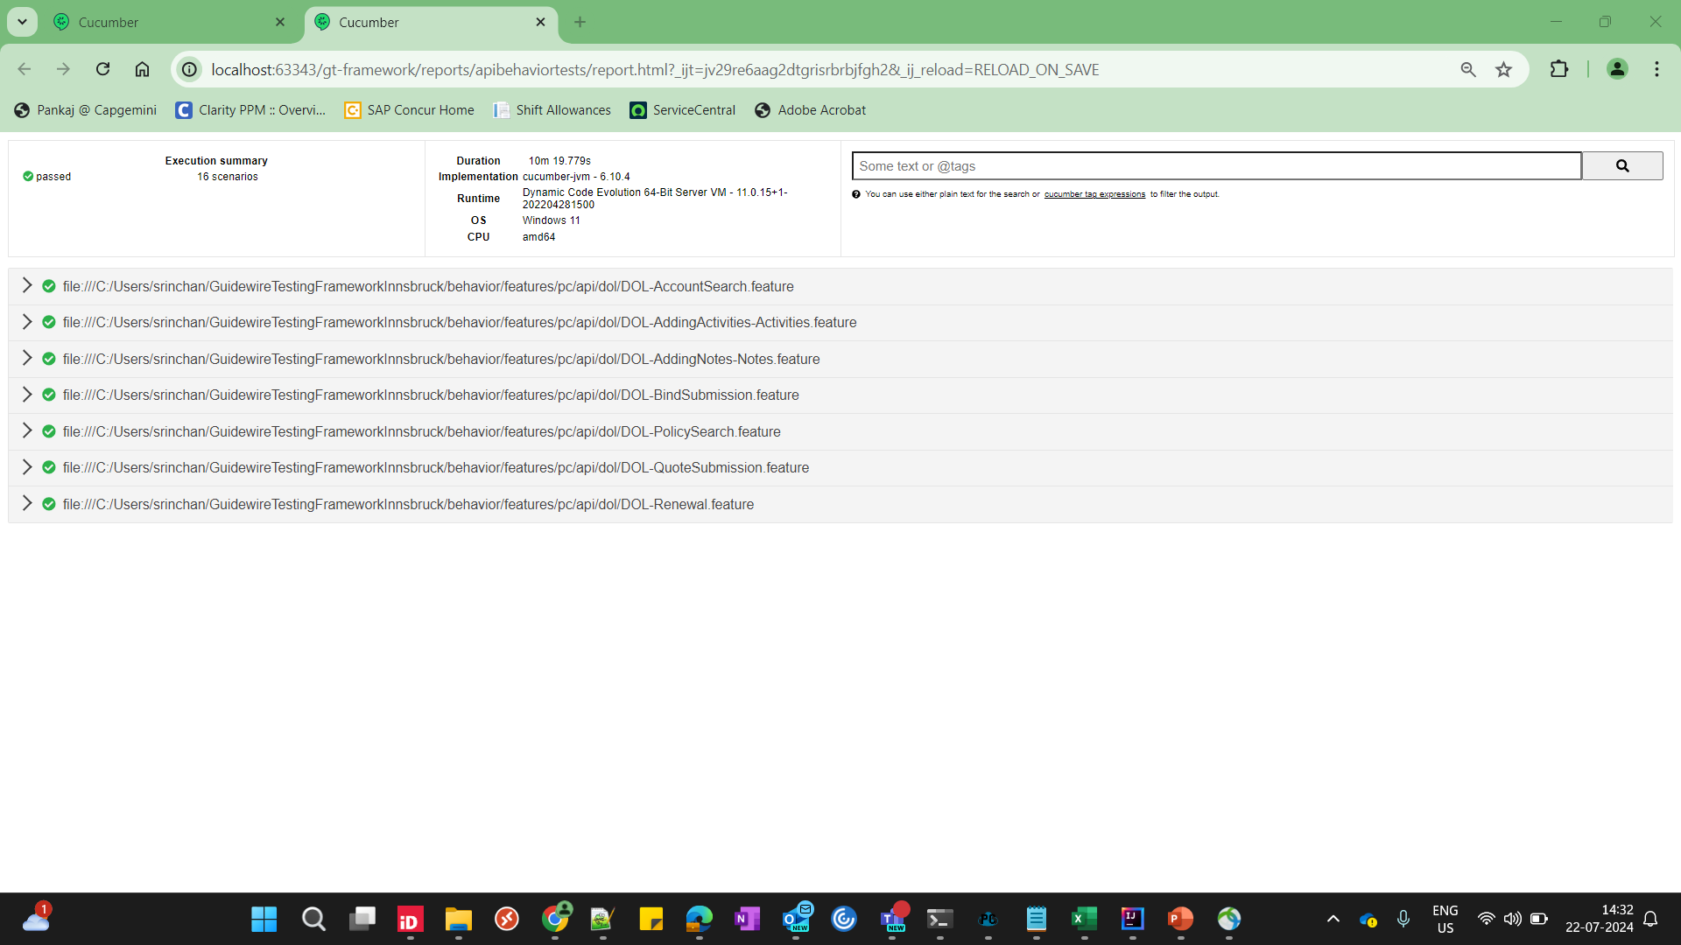
GW PC – Designated API – GT API
Designated functions executed – GT API:
Searching for Account
(Search an existing account number with account holder name or account number)
Adding Activity
(Add activity to account and policy)
Adding Note
(Add note to account and policy)
Submission quoting
(Create a new submission and Quote)
Submission Binding
(Create a new submission and Bind)
Searching for Policy
(Search for a policy with policy number)
Renewal
(Renewed a policy term)
Test-Data:
Searching for Account with account holder name |  | Searching for Account with account number | Adding an activity to an account/policy | Adding an note to an account/policy
First Name | Last Name | Account Number | New Activity | New Note
Ray | Newton | 5487005930 | New mail - Review new mail | Coverage requests
Adam | Kumar | 2430943036 | Request - Create new producer | Loss Control
Kumar | Jeevan | 7011711080 | Meet with new insured | Financial Issues
Kims | Jhon | 8540931853 | Policy notification | Pre-renewal direction
Execution Report:

Slide 7
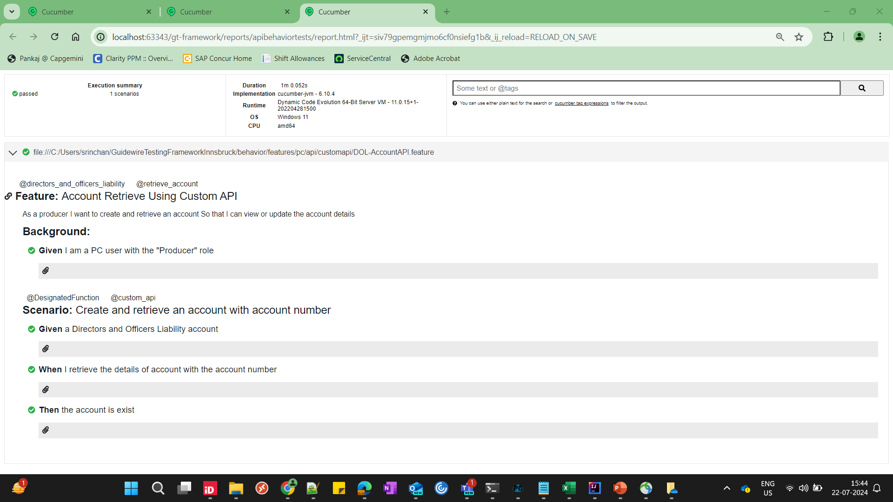
Customized API Testing with GT API - 1
Customized API functions executed – GT API:
Create the account API & Retrieve the account API
(A custom cloud API has been developed in GWPC. GT API script was developed and executed to create an account, retrieve to view account summary)
Execution Report:

Slide 8
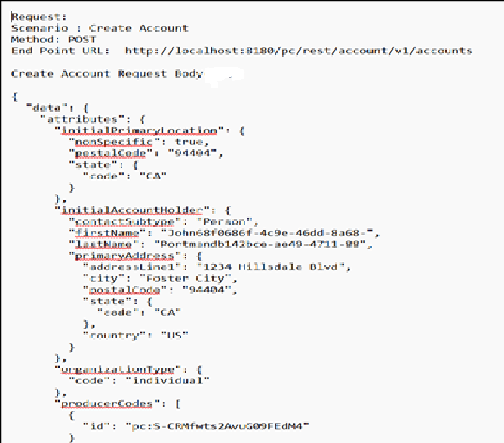
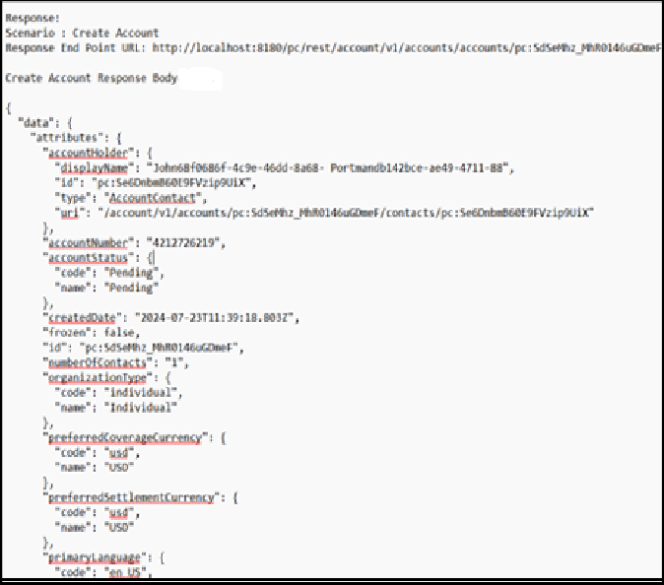
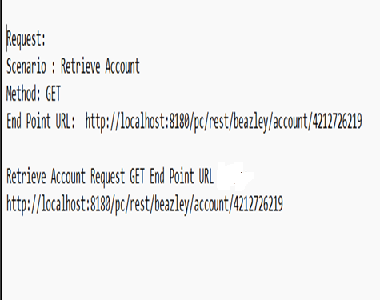
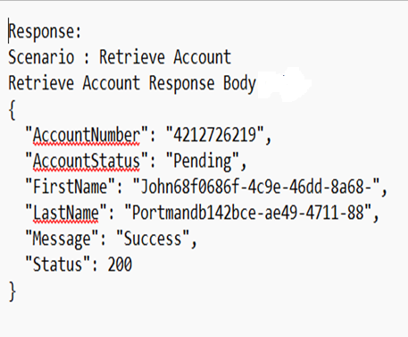
Customized API Testing with GT API - 2
Purpose of this is to call 2 customized APIs (Create account API & Retrieve account API) and get response.
Flow Diagram:
Create account API Request and Response JSONs:
GT API
Request JSON
Request JSON
Response JSON
Response JSON
Retrieve account API Request and Response JSONs:
Create account API
Retrieve account API
GW Policy Center

Slide 9
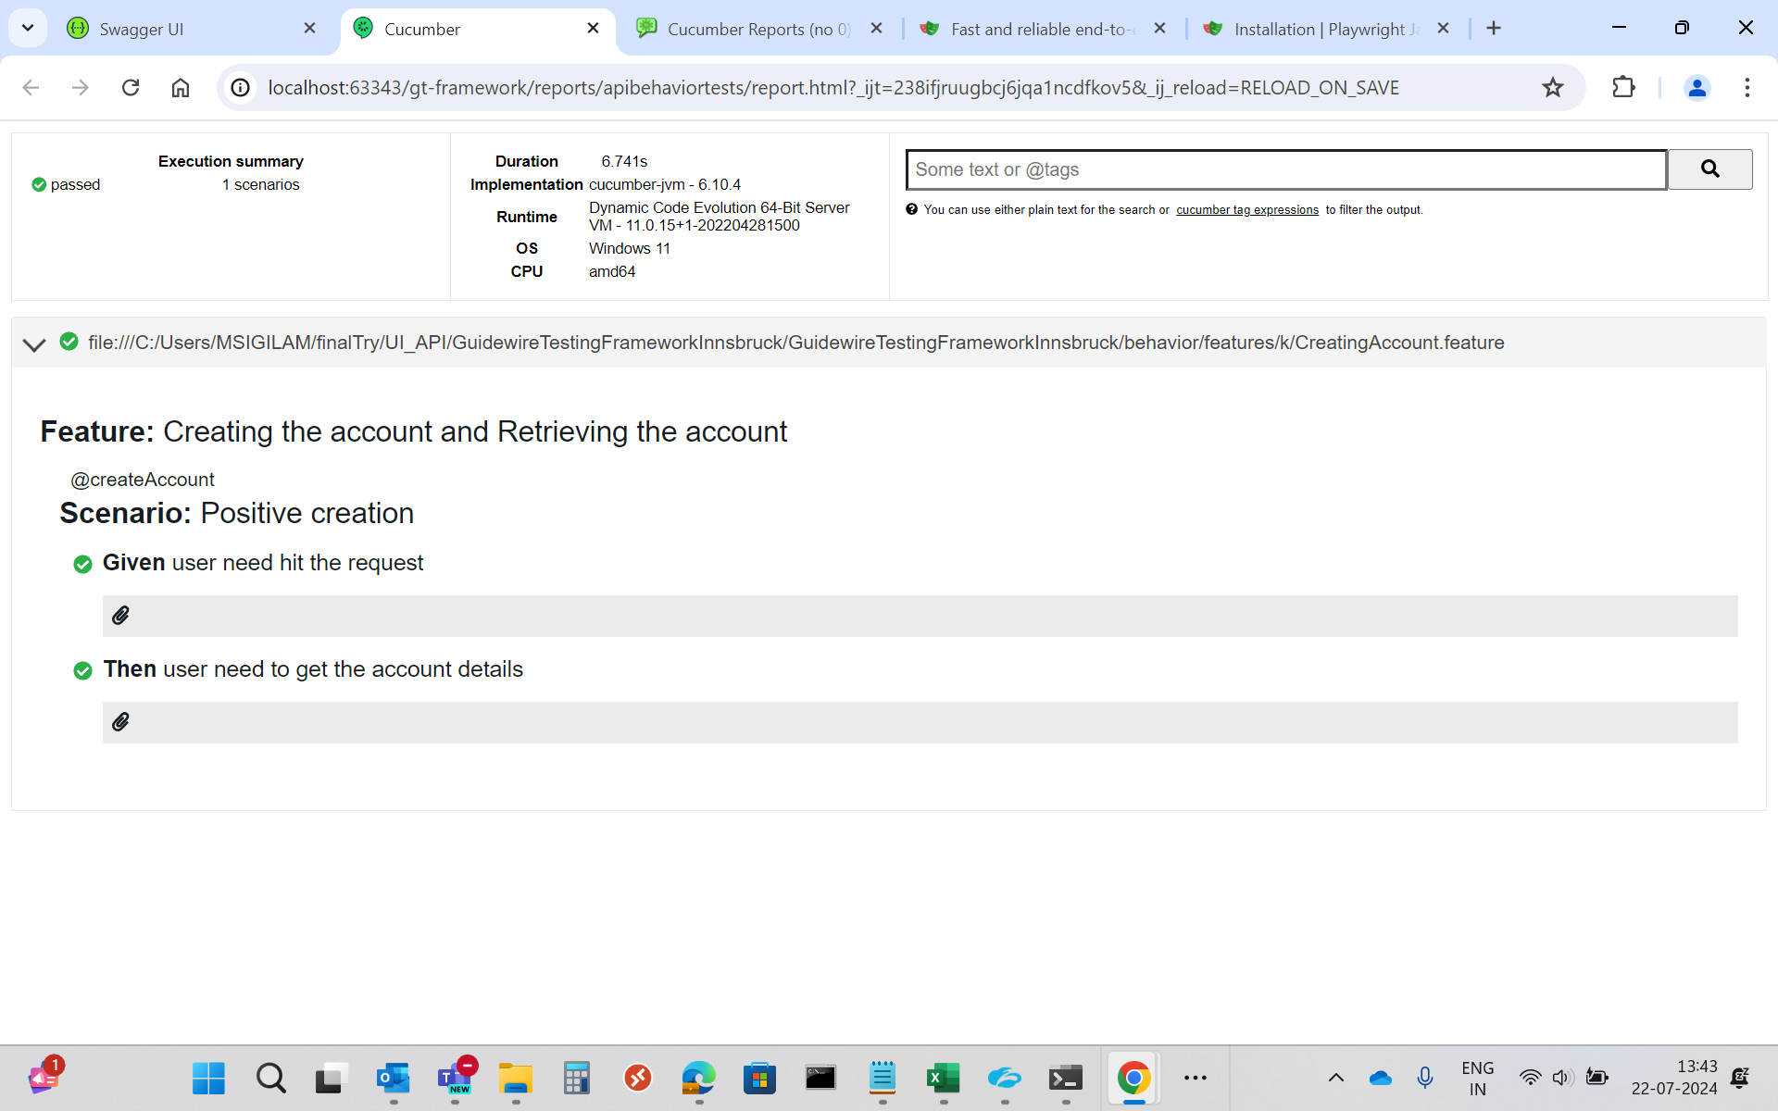
Cloud API Testing through Integration Gateway – GT API - 1
Cloud API testing through Integration Gateway functions with GT API:
Create the account & Retrieve the account
(A custom cloud API has been developed in Integration Gateway. GT API script was developed and executed to create an account, retrieve to view account summary through Integrated Gateway)
Execution Report:

Slide 10
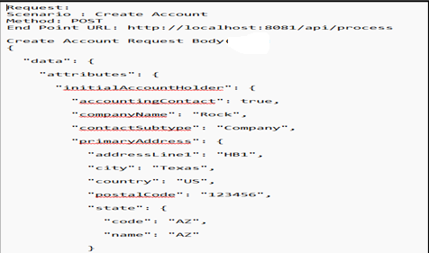
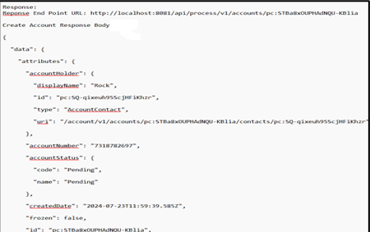
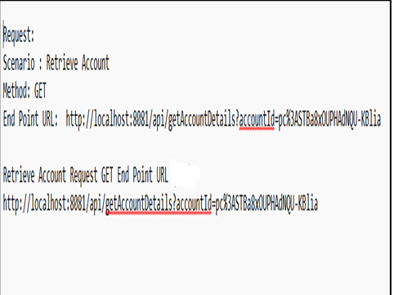
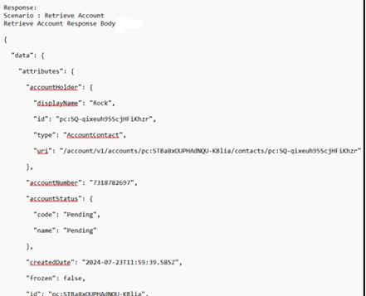
Cloud API Testing through Integration Gateway – GT API - 2
Purpose of this is to call 2 customized APIs (Create account API & Retrieve account API) through Integration Gateway and get response.
Flow Diagram:
Create account API Request and Response JSONs:
GT API
Response JSON
Response JSON
Request JSON
Request JSON
Integration Gateway
Create account API
Retrieve account API
Request JSON
Request JSON
Retrieve account Request and Response JSONs:
Response JSON
Response JSON
Create account API
Retrieve account API
GW Policy Center

Slide 11
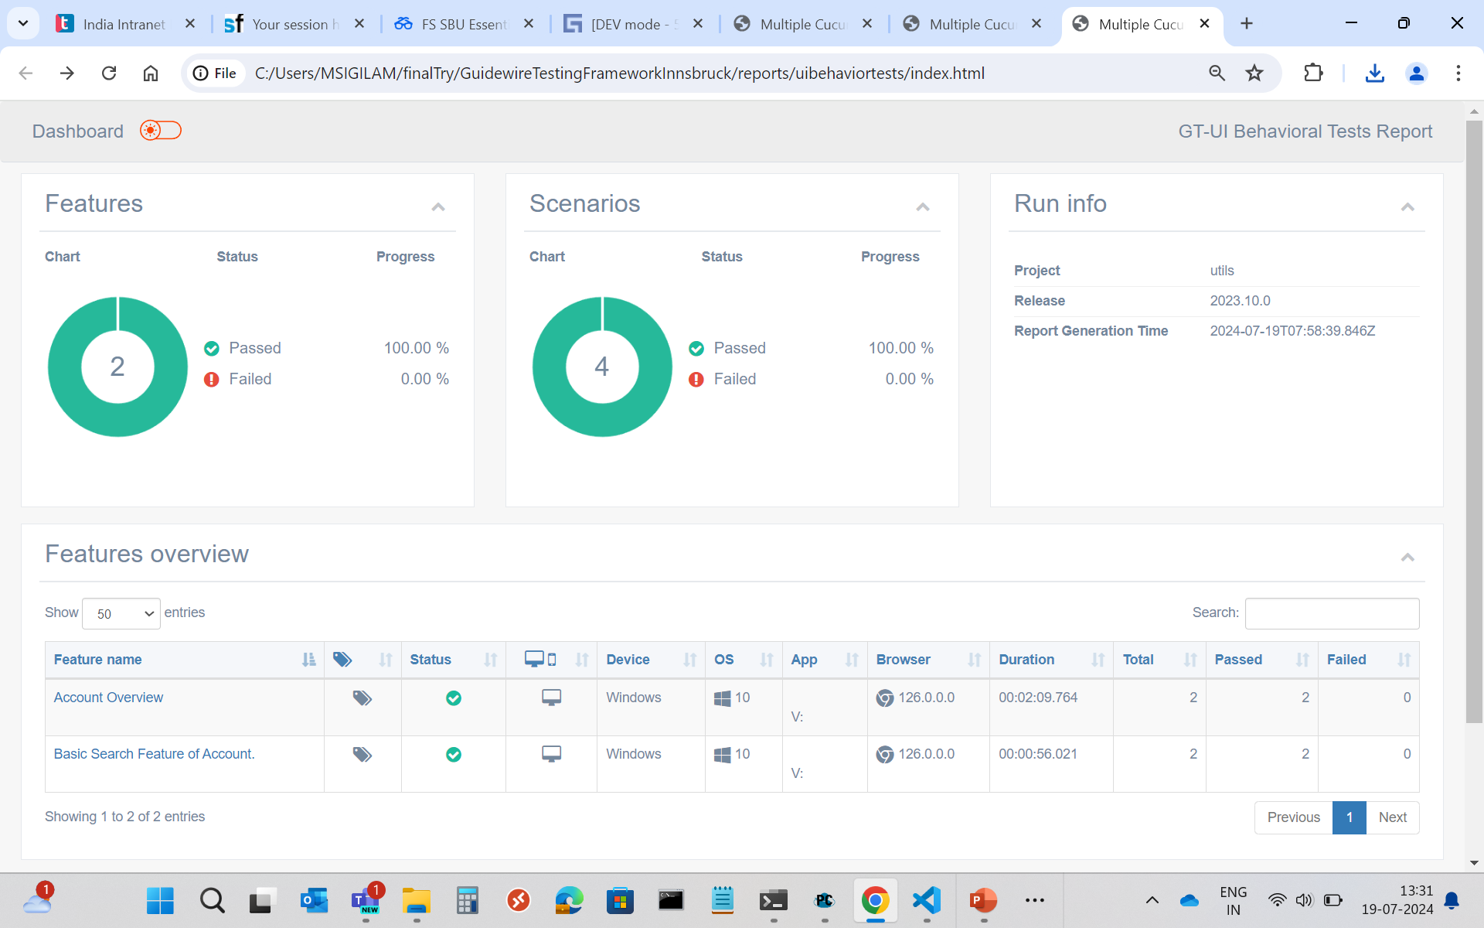
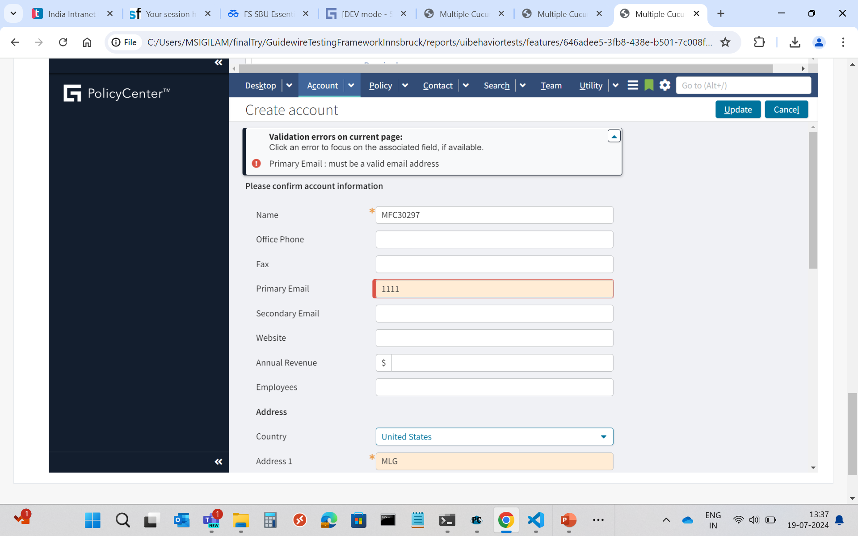
Test Data Parameterization – From External Source (Excel)
GT Framework can read from Excel sheet and populates the data into the application.
Test Scenarios :Account Creation and Overview.
Test Data:
Test Results:
Test-Type | CompanyName | Primary Email | Address1 | City | AddressType | organization
Positive | SMK | smk@gmail.com | HB | Haines City | home | acv
Negative | MFC | 1111 | MLG | Lake City | home | acv

Slide 12
Key features of GT Framework
Advantages:
GT Framework is part of GW OOTB package.
Designated functions scripts are already written and available. Enables faster testing with pre-automated scenarios using BDD approach.
Cloud API can be tested using GT API.
Skillset is available within the team.
Having Ignite tool within GT Framework, it avoids manual efforts drastically.
Limitations:
Any delay in Batch job response require manual intervention.
Any major limitations in the product release will end up waiting for a new product update (Eg: Browser crash issue observed till Cortina was resolved only in Elysian Version).
Guidewire not being open source, technical challenges can only be resolved via Guidewire support or internal knowledge base
Conclusion:
Being proprietary within Guidewire and POC being successful on key features of the framework, Capgemini recommends we use GT framework for all automation purposes for Sprint testing

